Slide 1

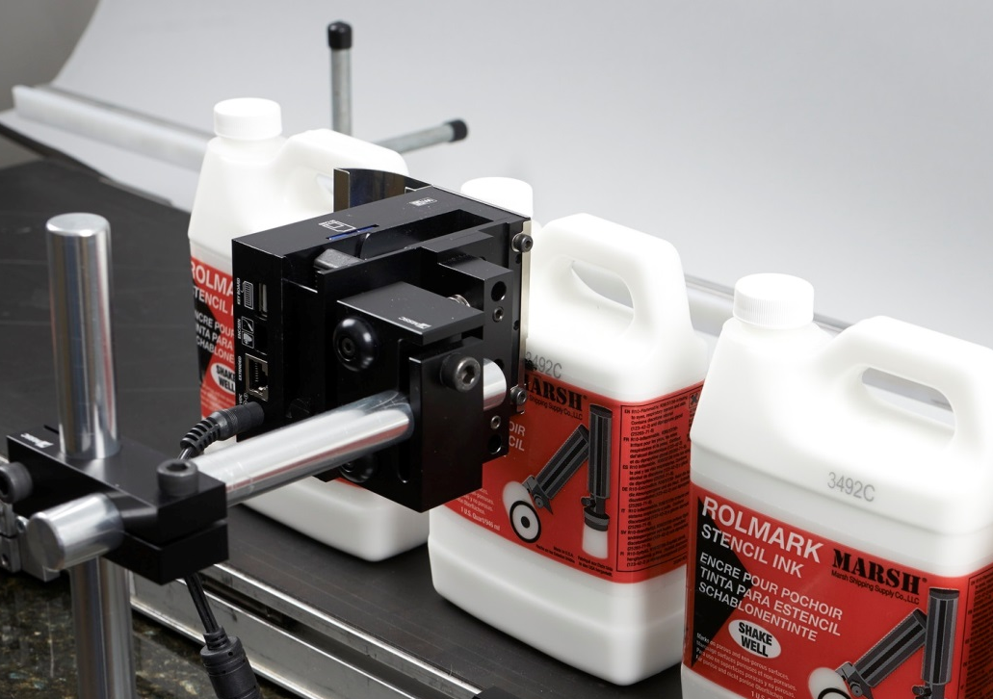
Presents:
Smart-Jet

Slide 2
Outline
What is Smart-Jet?
Design
Ease of operation
Wi-Fi
Firmware
Specs
Inks
Non-Porous Ink Samples

Slide 3
What is Smart-Jet?
Thermal inkjet (TIJ) technology
Low cost
Fully featured
Easy to operate
Smart device capabilities
Wi-Fi enabled
Complete system in a box
Porous and Non-Porous

Slide 4
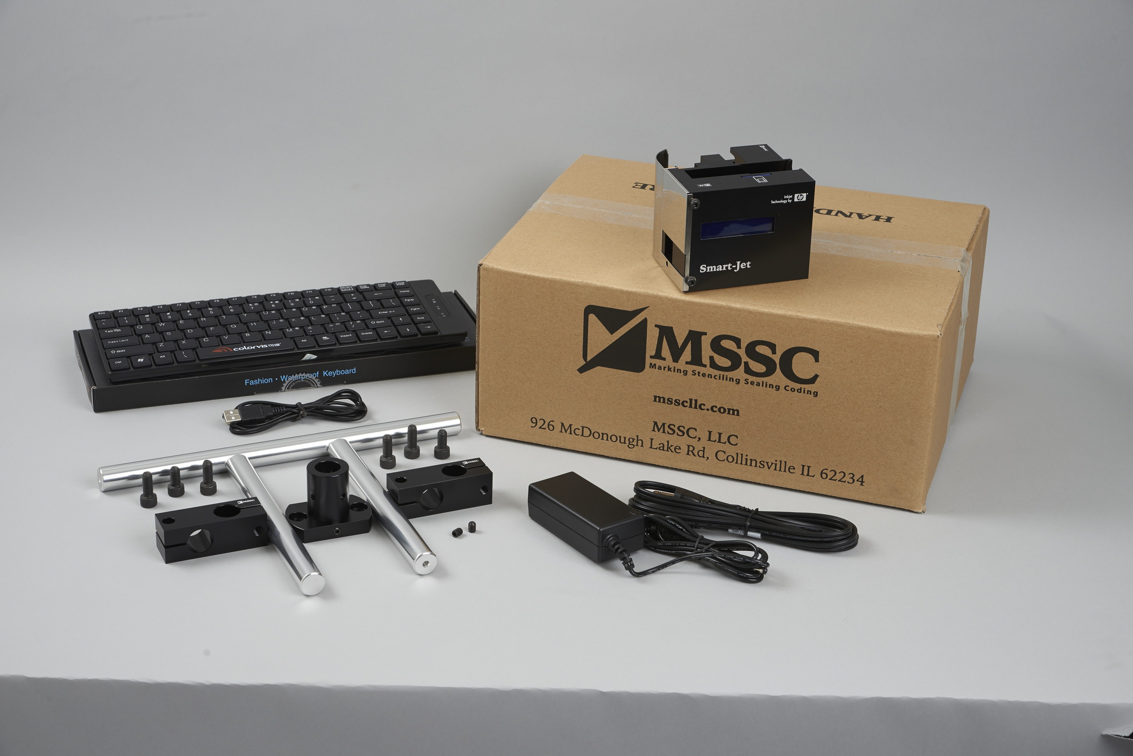
What’s in the Box?

Slide 5
Compact and Smart Design
Small physical head design: 4” X 2” X 3”
Weight w/o ink cartridge 1 lb.
Built in anti-shock mechanism (Slide Bracket)
Power supply AC 100v – 240v 50/60 hz
Secure HP 45 Smart Cartridge
    Automatically adjust voltages and drive pulse
    Requires MSSC Smart-Jet ink

Slide 6
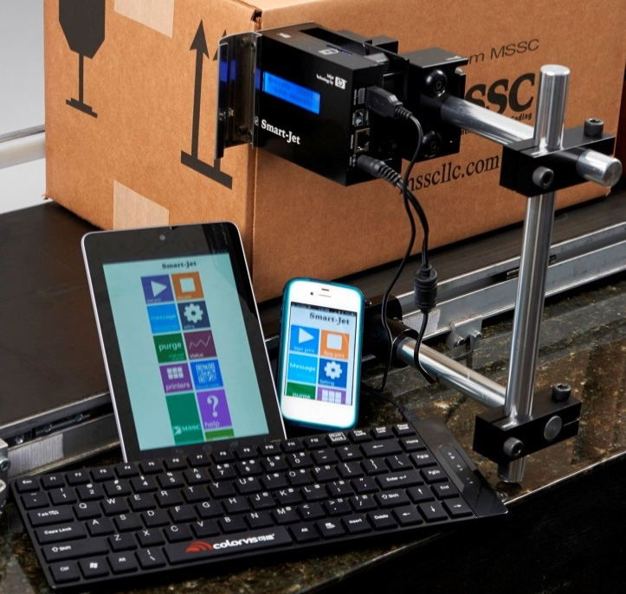
Ways to Operate
Two ways to operate
  Full QWERTY keyboard
  iPhone/Android Device
    Wi-Fi enabled
    Control up to 10 heads
    iOS and Android MSSC Apps
    Does not require internet

Slide 7
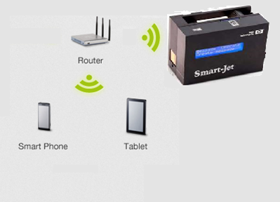
Wi-Fi Apps
Wi-Fi is local only
Internet not required
Password enabled

Slide 8
Firmware Features
Alphanumeric characters
Logo
Barcode
Date/Time
    Expiration date
    Julian date
    Rollover hour
    Shift codes (up to 5)
Counter
Programmable auto purge

Slide 9
Firmware cont.
1 or 2 lines of Hi-resolution print
2 Font Sizes
    Big Font: 0.5” (12.7mm)
    Small Font: 0.15” (3.8mm)

Slide 10
Resolutions and Speeds
Vertical Resolution = 300dpi
Horizontal Resolutions / Speeds
    300dpi / 246 FPM
    150dpi / 492 FPM
    100dpi / 754 FPM
5 levels of density

Slide 11
Inks
Porous
  Black
    Red, Blue, Green are available
  Bulk ink available in black (442mL)
Non-Porous
  Black, Blue, and Red
  Wide range of surfaces

Slide 12
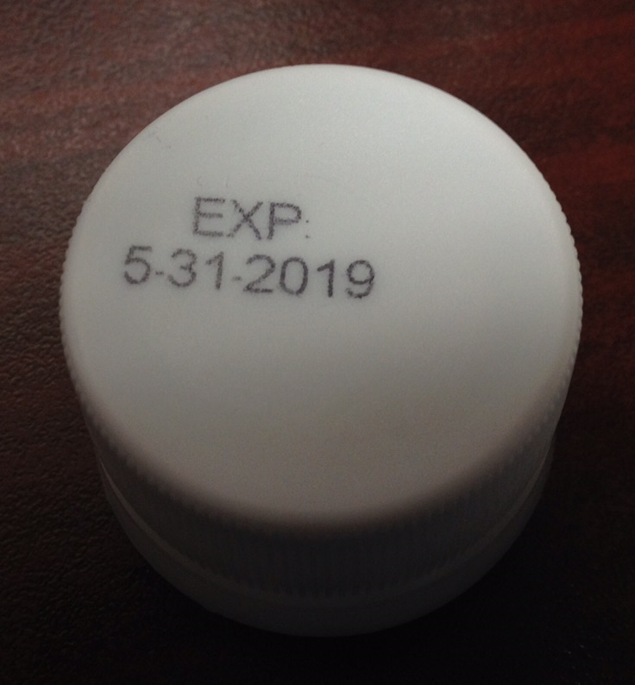
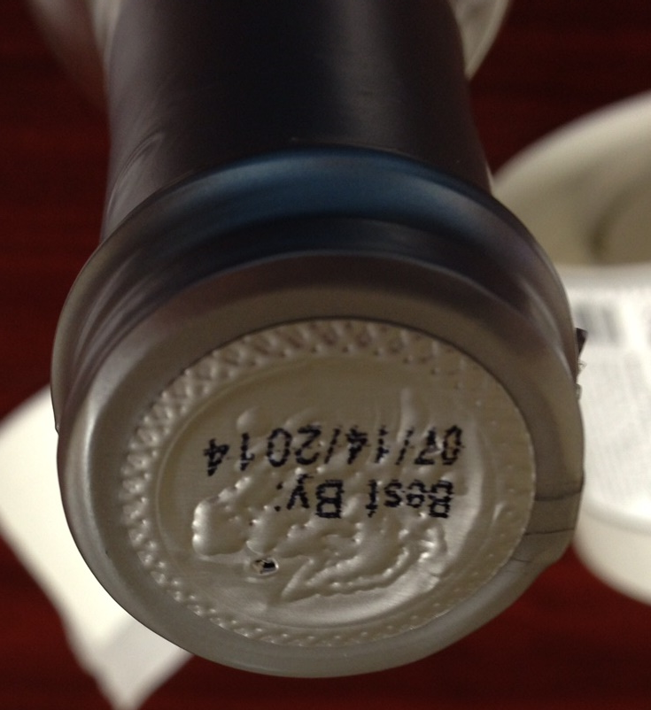
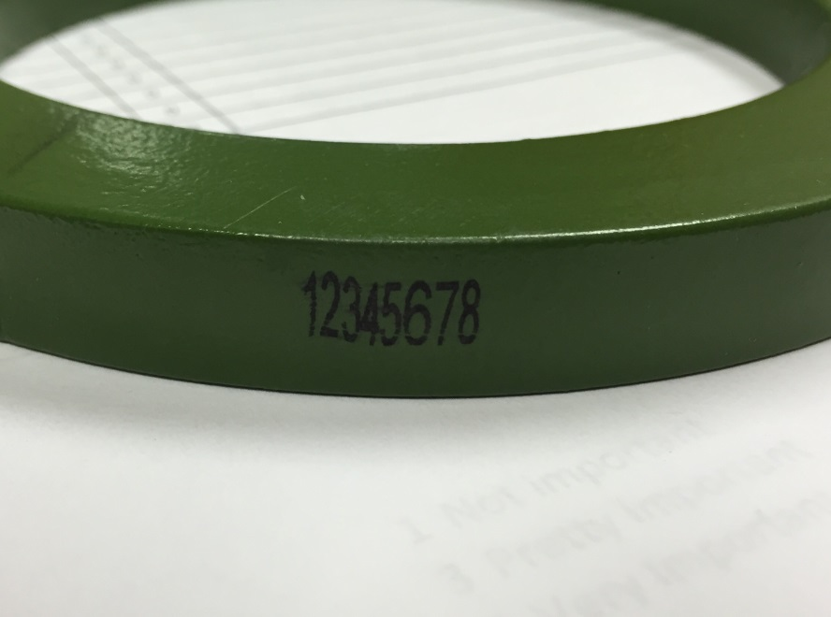
Non-Porous Ink Samples

Slide 13
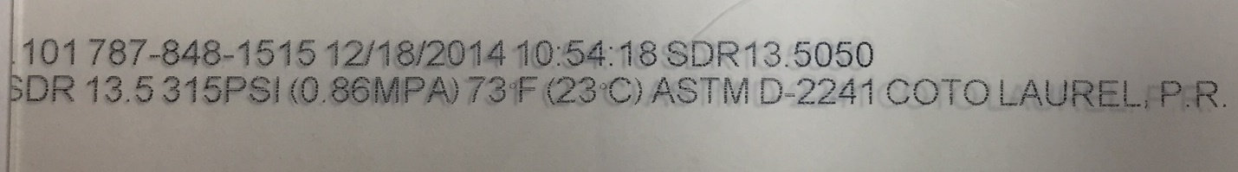
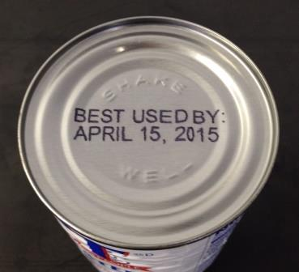
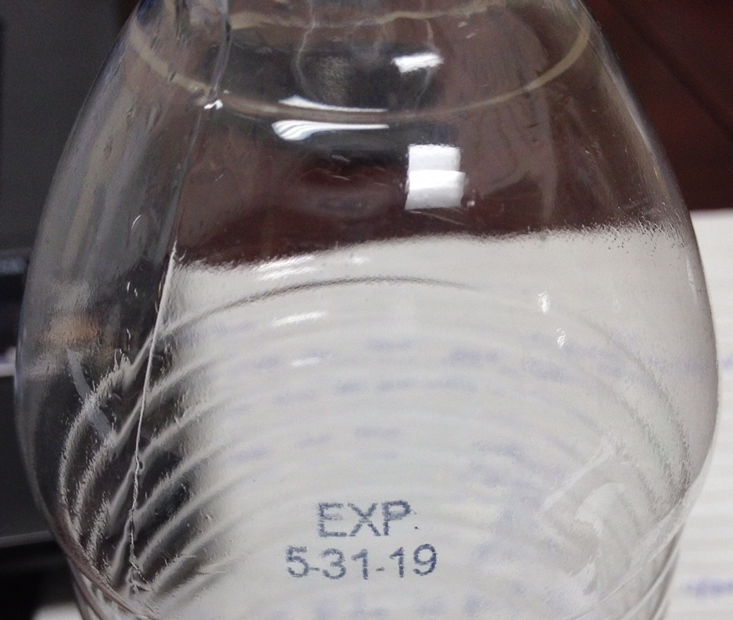

Slide 14
Questions?

