Slide 1


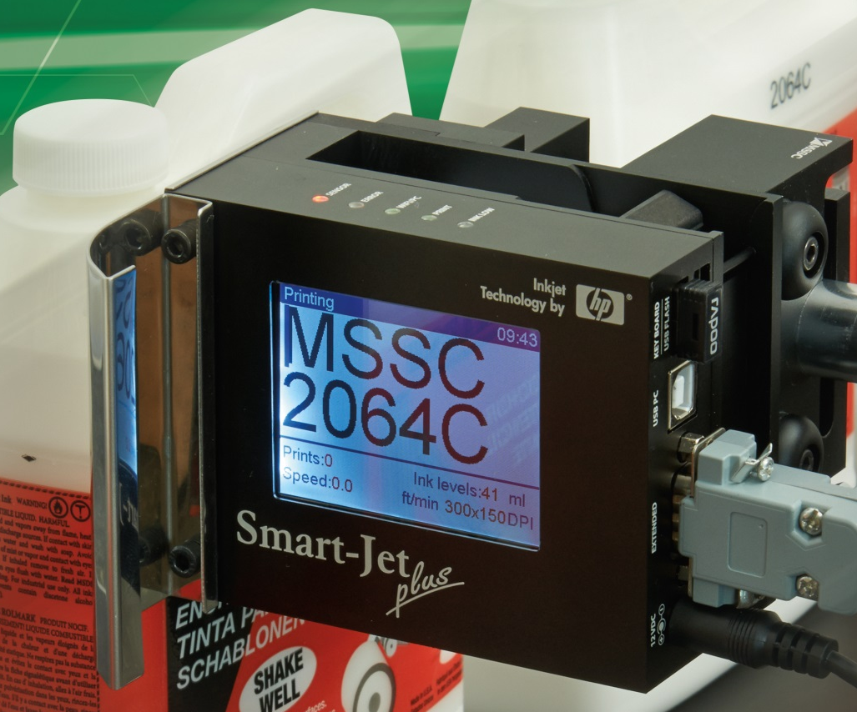
Presents:
Smart-Jet Plus

Slide 2
Outline
What is Smart-Jet Plus?
Design
Ease of operation
Wi-Fi
Firmware
Specs
Inks
Non-Porous Ink Samples
Comparison Smart-Jet vs. Smart-Jet Plus

Slide 3
What is Smart-Jet Plus?
CE Approved Thermal inkjet (TIJ) technology
Low cost
Fully featured
Easy to operate
Smart device capabilities
Wi-Fi enabled
Computer/ database connection
Complete system in a box
Porous and Non-Porous

Slide 4
Compact and Smart Design
Small physical head design: 4” X 2” X 3”
Weight w/o ink cartridge 1 lb.
Built in anti-shock mechanism (Slide Bracket)
2.8” Auto-rotating LCD screen
Power supply AC 100v – 240v 50/60 hz
Secure HP 45 Smart Cartridge
    Automatically adjust voltages and drive pulse
    Requires MSSC Smart-Jet ink

Slide 5
Ways to Operate
Three ways to operate
  Wireless QWERTY keyboard
  iPhone/Android Device
    Wi-Fi enabled
    iOS and Android MSSC Apps
    Control up to 10 heads
    Does not require internet
  PC Program

Slide 6
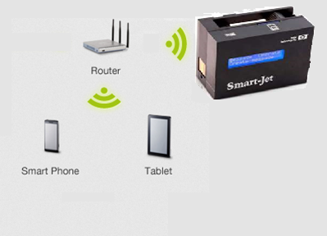
Wi-Fi Apps
Wi-Fi is local only
Internet not required
Password enabled

Slide 7
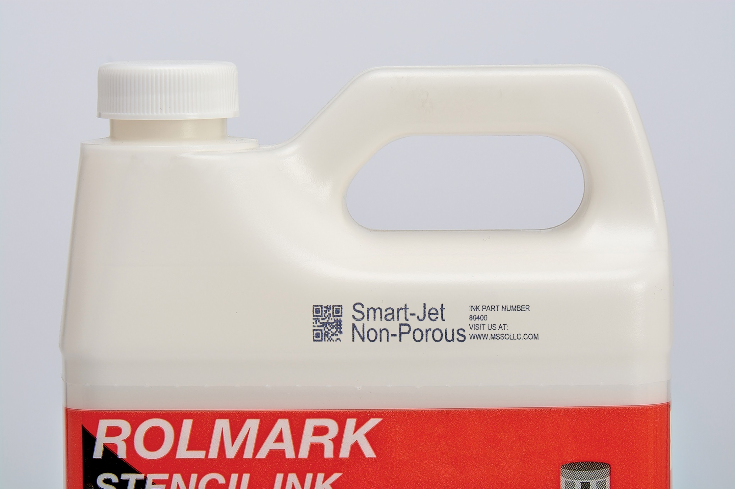
Firmware Features
Alphanumeric characters
Logos (up to 4)
Dynamic barcodes (2D/QR Codes too!)

Slide 8
Firmware Features
Date/Time
    Expiration date
    Julian Date
    Rollover Hour
    Shift Codes (up to 5)
Counter
Programmable auto purge

Slide 9
Smart-Jet Plus Features
Store up to 100 messages
Hot-swap cartridges
Adjustable photocell
Encoder capable
1 to 6 lines of print (standard)
4 Font Sizes
    Biggest Font: 0.5” (12.7mm)
    Smallest Font: 0.04” (1mm)

Slide 10

Smart-Jet Plus Benefits over Smart-Jet
Characteristics | Smart-Jet | Smart-Jet Plus
Universal Power Supply | Yes | Yes
Number of messages | 15 | 100
Characters per line | 15-70 Resolution dependent | Up to 150
Number of lines per message | 2 | 6
Logo | 1 | 4
Barcodes | With app | With keyboard, app, PC
Dynamic Barcodes | No | Yes
Encoder | No | Yes
Programmable auto purge | Yes | Yes
CE Approval | No | Yes
Built-in photocell | Yes - Adjustable | Yes - Adjustable
External Photocell | Yes | Yes
Number of font heights | 2 | 5
Hot-swap cartridges | No | Yes
Display size | 0.5" x 2.5“ LCD | 2.8" LCD auto-rotating
PC Connection | No | Yes
Porous Inks | Yes | Yes
Non-Porous inks | Yes | Yes
Bulk Ink | Yes | Yes

Slide 11
Resolutions and Speeds
Vertical Resolution = 300dpi
Horizontal Resolutions / Speeds
    300dpi / 75 m/min
    150dpi / 150 m/min
    100dpi / 230 m/min
5 levels of density

Slide 12
Inks
Porous
  Black
    Red, Blue, Green are available
  Bulk ink available in black (442mL)
Non-Porous
  Black, Blue, and Red
  Wide range of surfaces

Slide 13
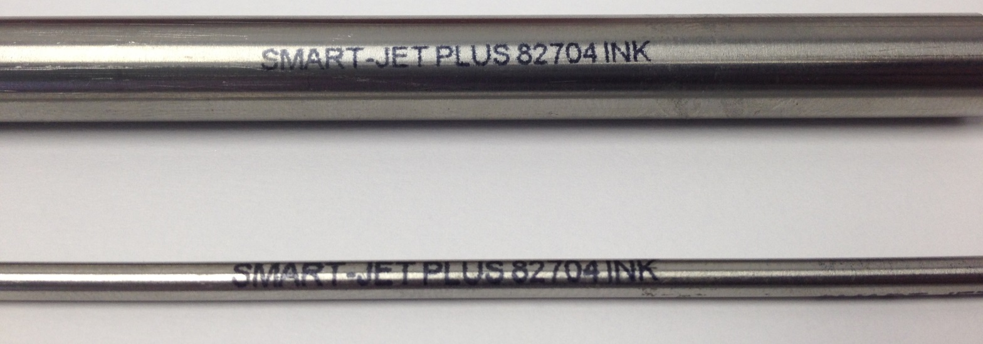
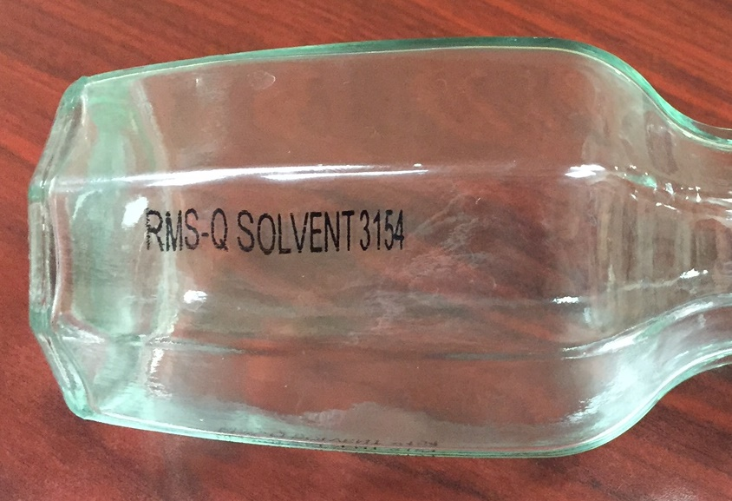
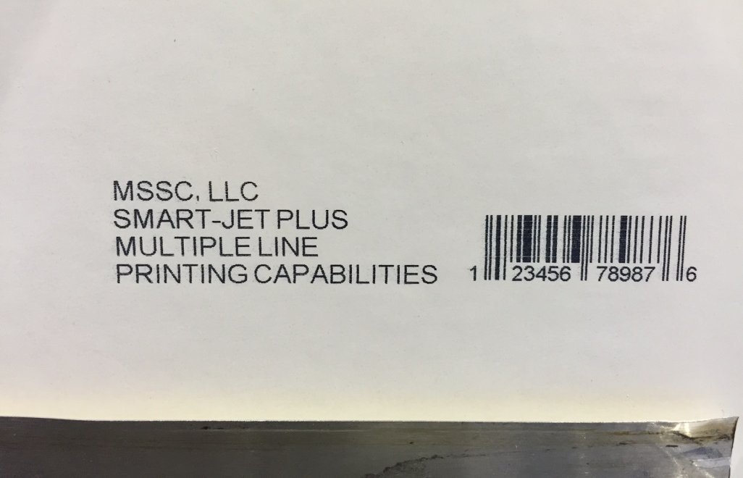
Non-Porous Ink Samples

Slide 14
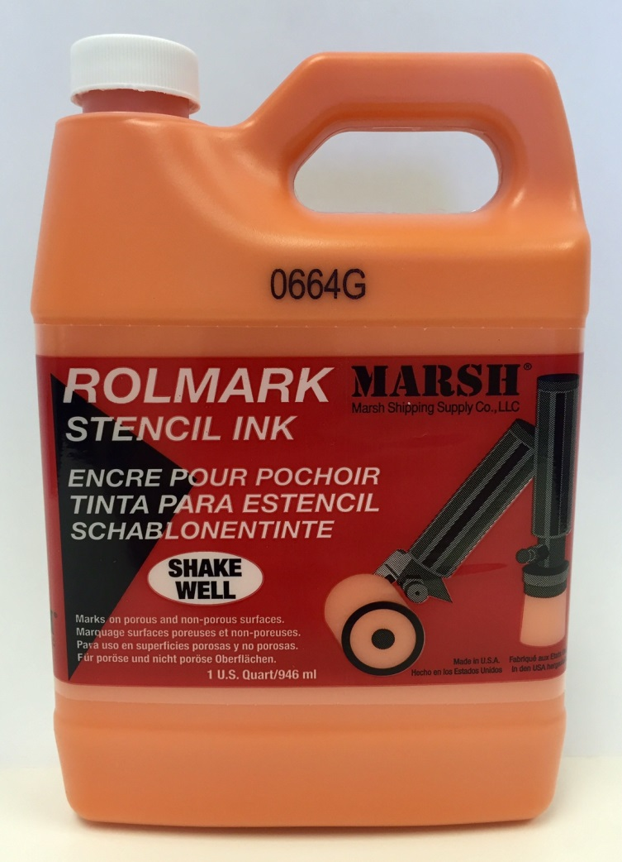
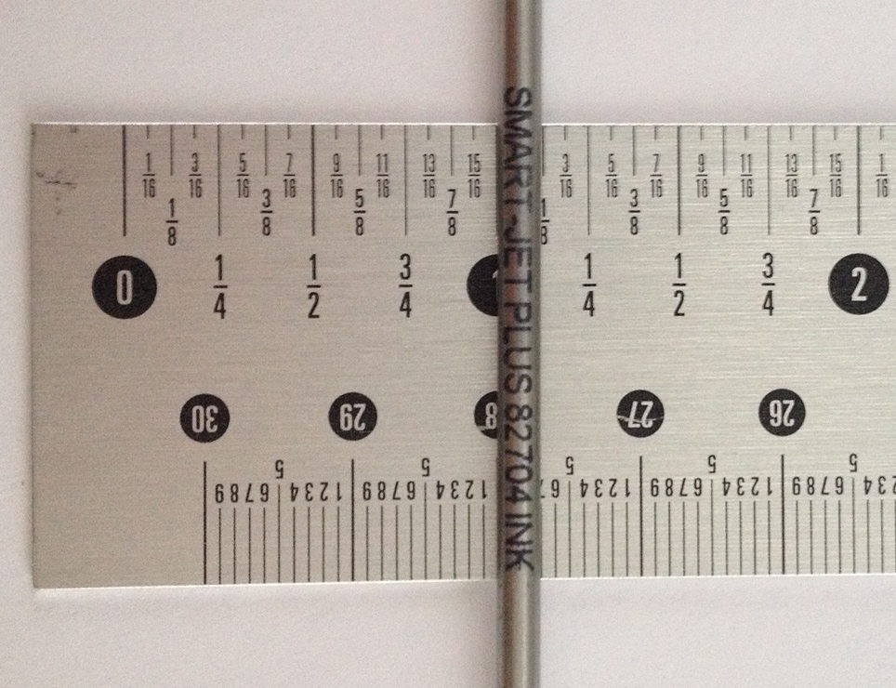

Slide 15
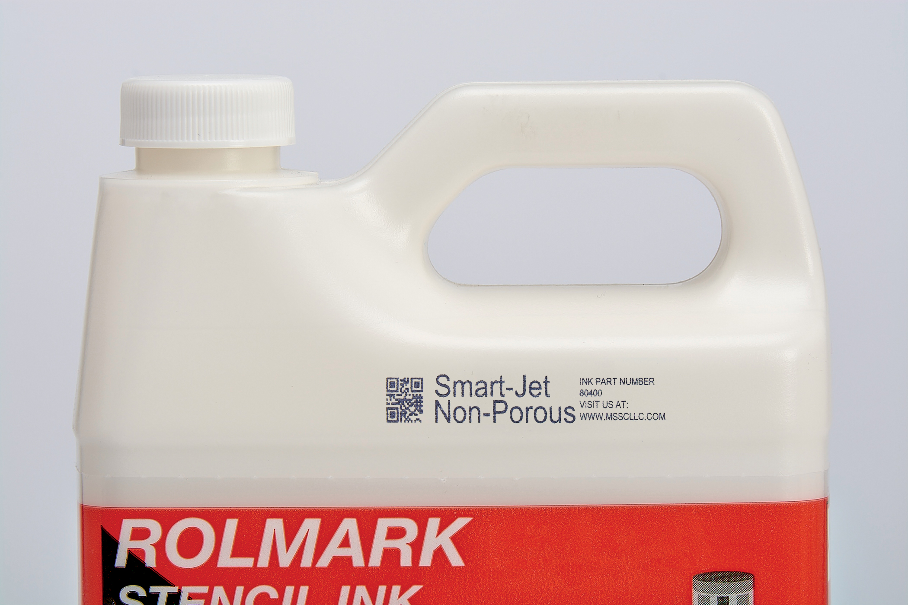
Questions?

